Slide 1
Playlist Manager
- M. Jeswanth Miracle Babu

Slide 2
Introduction
Playlist management is an essential part of the music industry, and it involves organizing songs into playlists for easy access and enjoyment. However, managing playlists can be a complex task, especially when dealing with large collections of songs. This is where hybrid data structures like doubly linked list graph, binary search tree, and hash table come in handy.
These data structures provide efficient ways to manage and manipulate playlists, making it easier to add, remove, rearrange, sort, and search songs. In this presentation, we will explore how these data structures work and their benefits in playlist management.

Slide 3
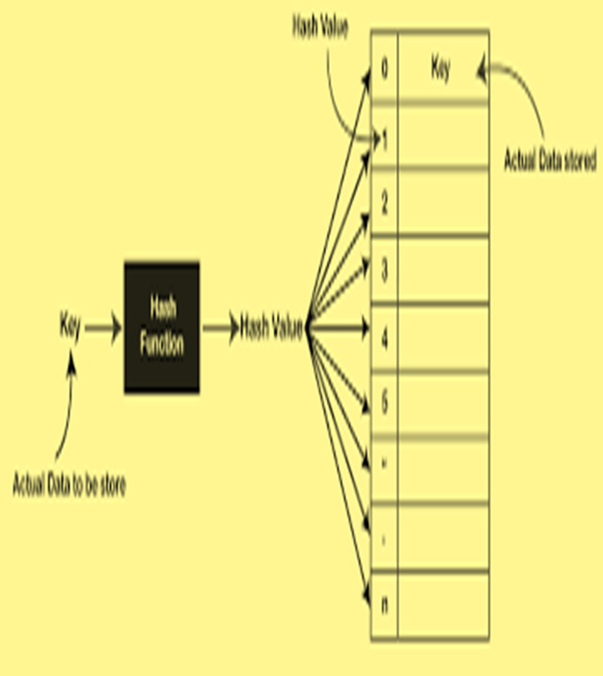

Data Structures Used:
Graphs
Hash Table

Slide 4
Hybrid Data Structure Implementation
In this implementation, the ‘Playlist’ class uses a linked list to manage the songs in the playlist. Each song has a ‘next’ pointer that points to the next song in the playlist. The ‘addSong’ method adds a new song to the end of the playlist, and the ‘removeSong’ method removes a song from the playlist.
Additionally, the Playlist class maintains a dictionary called ‘genre_map’ to store connections between songs based on genre. When a song is added, it is added to the genre-based connection list corresponding to its genre. The ‘getRecommendedSongs’ method allows you to retrieve a list of recommended songs based on a given genre.

Slide 5
Practical Applications
Music Playlist Management: The code allows users to create, manage, and manipulate playlists. Users can add songs, remove songs, search for songs, and display the playlist.
Song Recommendation: By utilizing the addConnection() method, the code establishes connections between songs based on their genre or artist.
Music Organization: The Binary Search Tree (BST) data structure implemented in the code allows efficient searching and sorting of songs based on their titles.
User Interface: The code includes a basic command-line user interface (PM class) that allows users to interact with the Playlist Manager functionalities.

Slide 6
Time Complexties
Adding a Song:
Creating a new Song object: O(1)
Adding the song to the end of the playlist: O(1)
Overall time complexity: O(1)
Removing a Song:
Searching for the song to remove: O(n)
Updating the pointers to remove the song from the playlist: O(1)
Overall time complexity: O(n)
Shuffling the Playlist:
Converting the linked list to an array: O(n)
Performing the Fisher-Yates shuffle algorithm: O(n)
Converting the shuffled array back to a linked list: O(n)
Overall time complexity: O(n)

Slide 7
Experimental Evaluation
The Song class represents a song object with attributes like title, artist, duration, and genre.
The Playlist class represents a playlist object and provides methods for adding songs to the playlist, removing songs from the playlist, and shuffling the playlist.
The PlaylistManager class represents a playlist manager object that can manage songs and playlists.
The BSTNode class represents a node in a binary search tree (BST) used for efficient searching of songs by their titles.
The HashTable class represents a hash table used for efficient searching of songs.

Slide 8
Summary
In conclusion, playlist managers are an essential tool for music lovers and professionals alike. The use of data structures like doubly linked list and graph can greatly enhance the efficiency effectiveness of playlist management. Doubly linked list is ideal for maintaining the order of the playlist and allowing for easy insertion and deletion of songs, while graph is useful in generating recommendations based on user preferences.
As technology advances, we can expect playlist managers to become even more sophisticated and personalized. We encourage you to explore playlist management further and discover the many benefits it has to offer.

Slide 9
Thank you

